Slide 1
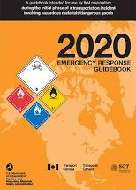
Hazardous Materials
Awareness
2023
Notes:
Hazardous Materials Awareness Training 2020-2021
Course Length
1.0 Hour

Slide 2
Hazardous Materials Awareness Level
  OSHA 1910.120(g)(6)(i)
    First responders at the awareness level are individuals who are likely to witness or discover a hazardous substance release and who have been trained to initiate an emergency response sequence by notifying the proper authorities of the release. They would take no further action beyond notifying the authorities of the release.
Notes:
Notes for the Instructor:
Read OSHA description of Haz. Mat. Awareness level responder
Discuss this description to the class and discuss who this encompasses:
Fire
EMS
Law Enforcement
Public Works
DOT

Slide 3
Training Objectives (1 of 2)
The responder shall understand what hazardous substances are and the risks associated with them in an incident.
Notes:
Notes for the Instructor:
Review briefly and move on.

Slide 4
Training Objectives (2 of 2)
The responder shall understand their role in the emergency response including site security and control and the use of the U.S. D.O.T Emergency Response Guidebook.
The responder shall have the ability to realize the need for additional resources, and to make the appropriate notifications to the communication center.
Notes:
Notes for the Instructor:
Review briefly and move on.

Slide 5
Hazardous Substances
Dangerous goods, also called hazardous materials or Haz. Mat., are solids, liquids, or gases that can harm people, other living organisms
Notes:
Notes for the Instructor:
This is the OSHA definition of hazardous substances.
As a group, discuss examples of Haz. Mat.

Slide 6
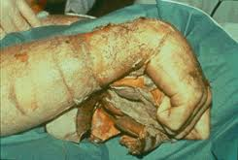
Dangers of Hazardous Substances
Contamination
Illness
Injury
Death
Long Lasting Environmental Effects
Decomposition
Chemical Degloving from Sulfuric Acid Exposure
Notes:
Notes for the Instructor:
Read each danger type to group and discuss examples of each:
Contamination – Discuss contamination with group and discuss ideas of the concept.
Illness – Humans, plants, animals.
Injury – People, plants, planet
Death – Acute and long term effects
Long lasting environmental effects – 10 / 20 / 50 / 100 year problems
Decomposition – Rapid eating away at solids.

Slide 7
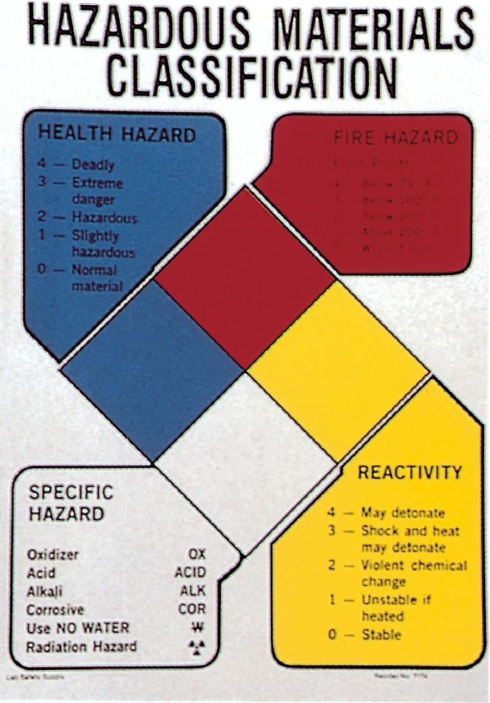

Haz. Mat. Identification
Visual Cues
NFPA 704
Placards
SDS
Shipping Papers
Notes:
Notes for the Instructor:
As a group, discuss the visual cues and give examples:
Visual Cues:
Vapor Clouds
Visible Fluids
Containers
The 4 other identifying systems are covered in the next several slides

Slide 8
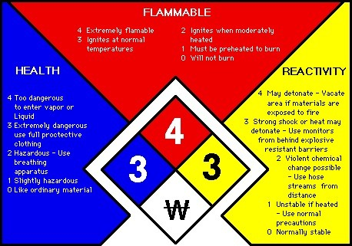
NFPA 704
(OXY – Oxidizer / ACID – Acid / ALK – Alkali / COR – Corrosive)
Notes:
Notes for the Instructor:
Explain each section of the NFPA 704 diamond
Blue – Health (0 – 4)
Red – Flammability ( 0 – 4 )
Yellow - Reactivity (0 – 4)
White – Special Hazards
Discuss where the 704 system is used and how it is beneficial to first responders

Slide 9
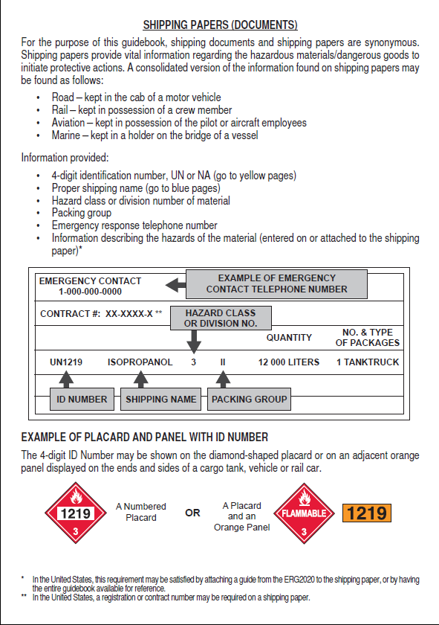
ERG and Shipping Papers
The 2020 ERG has a special section (inside the front cover) that specifically covers shipping papers.
Notes:
Notes for the Instructor:
This slide is an introduction slide.
Have students open the 2020 ERG to the inside front cover
Go to the next slide

Slide 10
Emergency Response Guidebook
Use during initial phase of incident
5 Sections
  Yellow
  Blue
  Orange
  Green
  White
Notes:
Notes for the Instructor:
Discuss when the ERG is used doing an emergency
Highlight that the ERG is an INITIAL reference for first responders, not the ONLY reference
Changes of the 2020 ERG are discussed next
Each color section is detailed after

Slide 11
Summary of changes to the 2020 ERG
Link to 2020 ERG Changes

Slide 12
The White Section
Shipping Papers
A “Down and Dirty” How To guide
Emergency Response Steps
Introduction to using the Placards Table
Notes:
Notes for the Instructor:
The front white pages:
Response information instead of instructions to use.
Added Information
Inside front cover is the shipping papers document
Page 1 is a brief “How To” for anyone who has never used the ERG, not a detailed instruction manual.
An introduction to the Page 7 Placards table has been added.

Slide 13
White Reference Section
The “White” Pages
  The instructions
  Size Up information
  Definitions
  BLEVE Table ( Page 367)
  CBRNE Information (Page 368)
  Contact Information (Page 391)
Notes:
Notes for the Instructor:
The rear White section is a collection of usual information that is not normally referenced during an emergency situation
Page 354 thru 359 – The instructions on how to use the book
Page 365 is the BLEVE information section
Page 367 is the BLEVE distances and fire flow table
Page 368 is a CBRNE reference Guide
THIS SECTION IS A REFERENCE FOR EDUCATION AND SHOULD NOT BE A GUIDE USED DURING AN CBRNE EMERGENCY
Page 373 is an IED stand off distance guide
Brief table of probable safe distances dealing with IED
Glossary on pages 375 – 385
Contact information Page 391

Slide 14
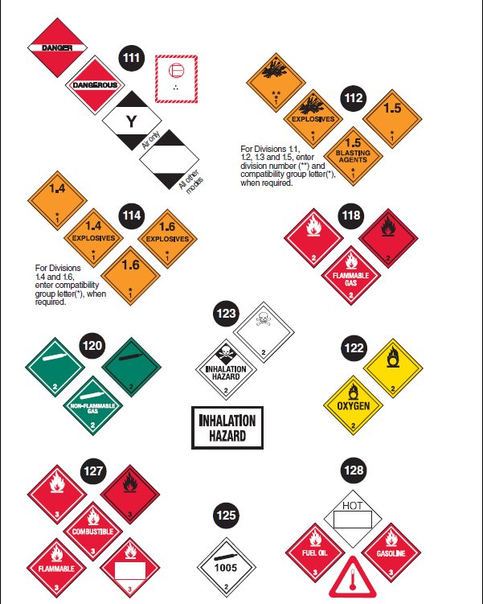
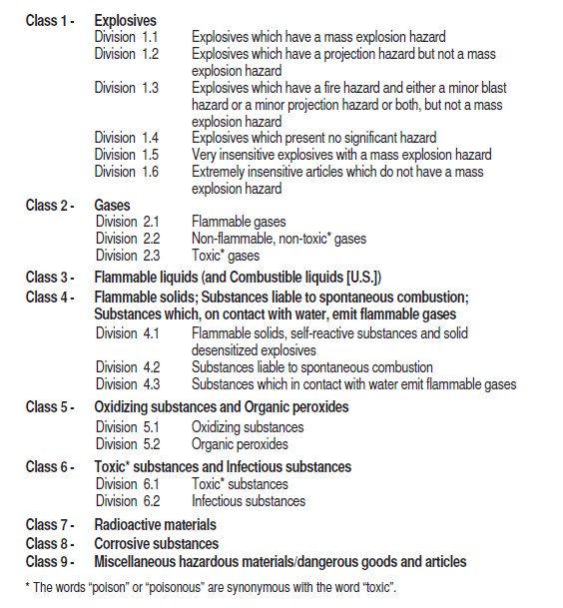
Placards
Notes:
Notes for the Instructor:
Have the students go to pages 8-9 in the 2012 ERG
Each hazard class has its own group of placards
Discuss the 9 hazard classes and the placards color and description that are within that hazard class
Hazard class 1 – Explosives
Hazard class 2 – Poisonous Gases
Hazard class 3 – Compressed Gases
Hazard class 4 – Flammable Solids
Hazard class 5 – Oxidizers
Hazard class 6 – Poison Liquids
Hazard class 7 – Radioactive substances
Hazard class 8 – Corrosives
Hazard class 9 – Misc. Haz. Mat

Slide 15
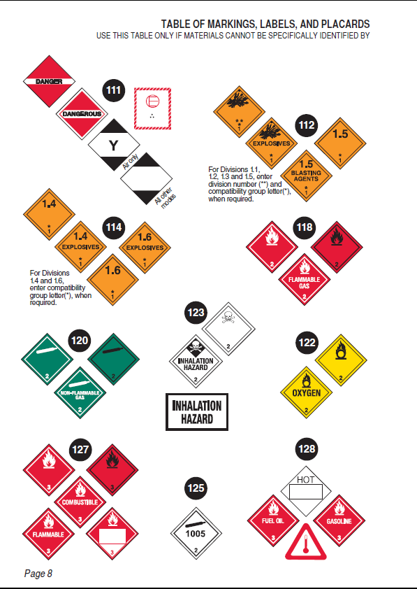
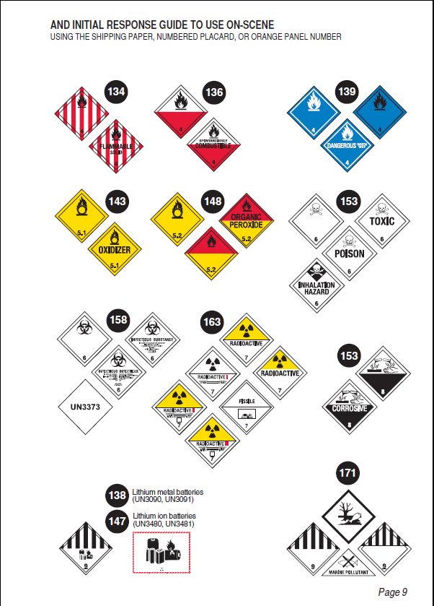
Placards Table
Notes:
Notes for the Instructor:
Have all students go to page 8-9
Note that a new placard has been added under guide 111 “Misc. Cargo” placards in the upper left hand corner of page 8
The Y and blank black and white placards are now used for Limited Quantities of Miscellaneous dangerous goods

Slide 16
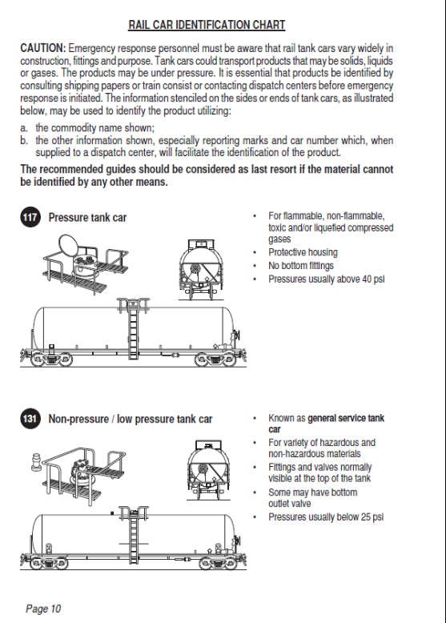
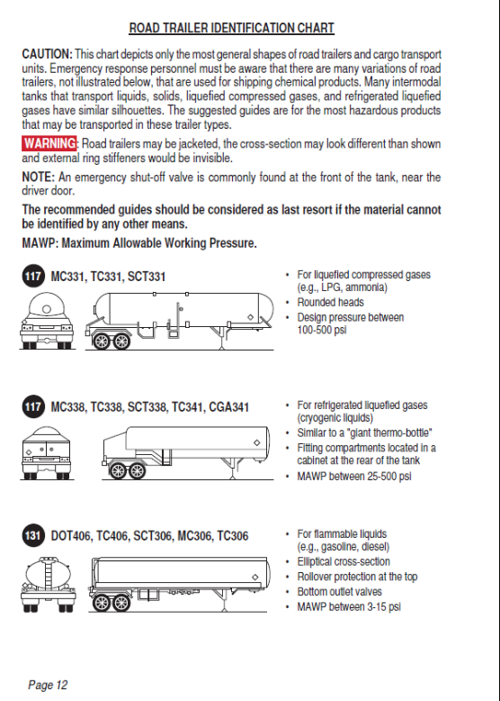
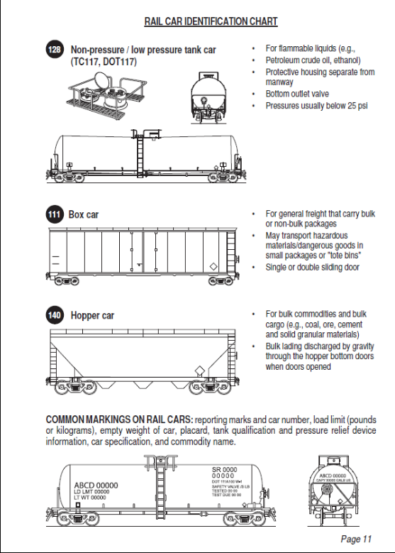
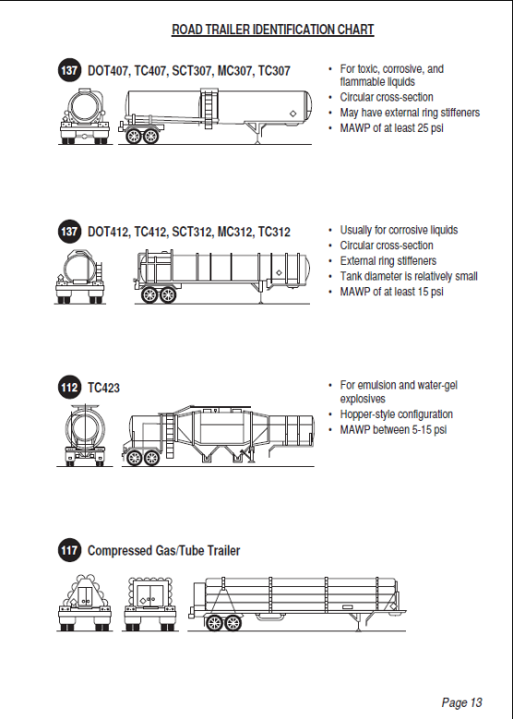
Tanks and Trailers Table
Notes:
Notes for the Instructor:
Have users go to page 10-14 and discuss the different tanks, trailers and containers
Remind students that pages 10-14 are to be used as a LAST resort

Slide 17
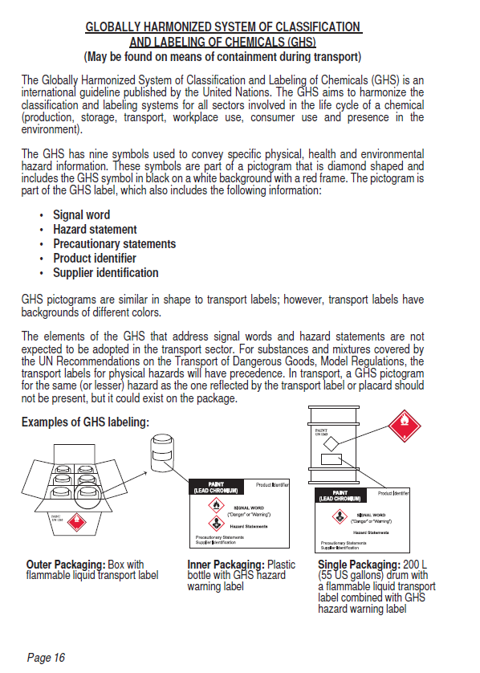
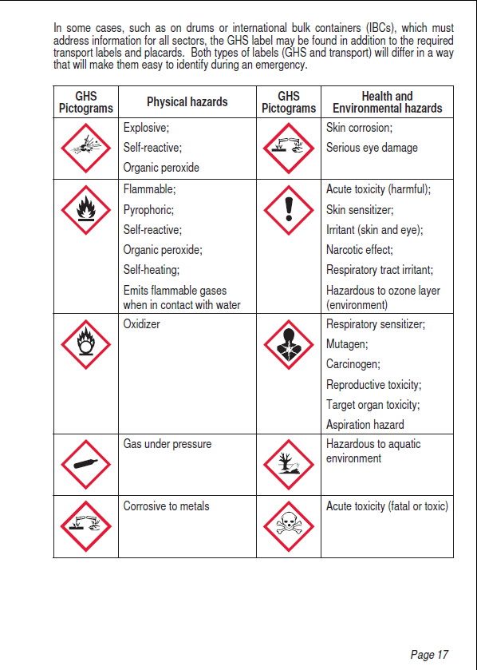
Global Harmonized System
(Added in 2016) Pages 16-17
Notes:
Discus GHS Pictograms

Slide 18

Intermodal Container Labeling
Pages 18 – 21 are dedicated to Intermodal Containers
Intermodal container use for hazardous materials transportation was up 42% from 2006 to 2011
Notes:
Notes for the Instructor:
Have users go to page 18.
Discuss “what are intermodal containers?”
Discuss how the identification system works
Discuss the “doubling” of hazards
Discuss “X” means water reactive
Have students review pages 18 – 21

Slide 19
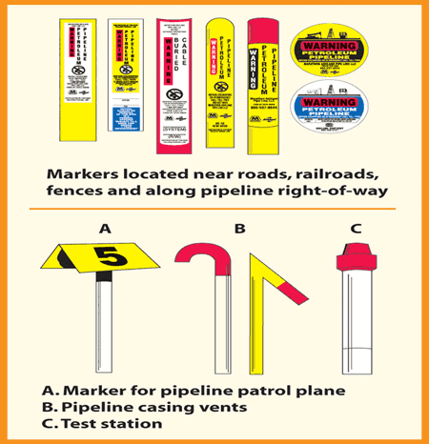
Pipeline Transportation
Pages 22 – 27 are dedicated to Pipeline based emergency response and identification.
Notes:
Notes for the Instructor:
Have group go to page 22.
Pages 22 – 27 cover Pipeline transportation
This section has been expanded significantly and you should spend some time discussing this section
Highlights to cover:
Structures
Compressor Buildings / Valves / Meter Stations / Patrol Markers
Markers
“Warning” “Caution” “Danger”
Found at Road, railroad and water crossings
Natural Gas incidents safety:
Never extinguish a natural gas fire (Page 25)
Never operate pipeline valve (Page 25)
Liquid Pipelines
Structures
Storage tanks / Valves / Pump Stations / Patrol Markers
Markers:
Found at road, railroad and water crossings

Slide 20
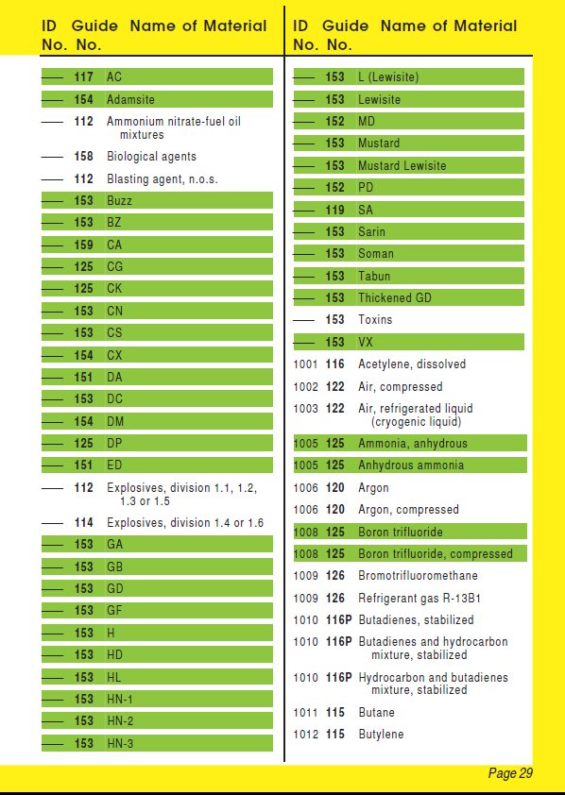
Yellow Bordered Pages
YELLOW Section is Listed in order of UN number
GREEN Highlights = If no fire, go to GREEN section
Notes:
Notes for the Instructor:
Instruct the class to go to page 28
The Yellow section is used to find hazardous materials by their UN number
The Haz. Mat. Highlighted in green identifies that material as being listed in table 1 of the green section.
Table 1 is initial isolation distances
ONLY USE THE GREEN SECTION IF THERE IS NO FIRE
Ask the class “On Page 29 UN Number 1010, the guide number is 116P. What does the P signify?
(answer is on page 1 of the ERG ---- “P” means material will undergo violent polymerization if subjected to heat or contamination)

Slide 21
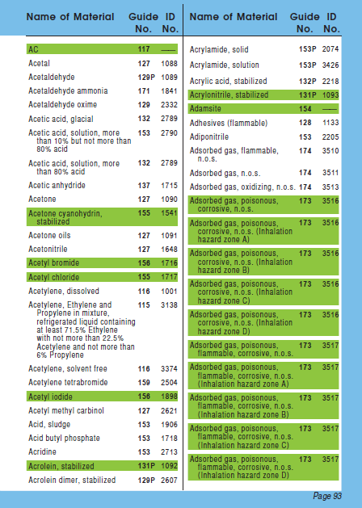
Blue Bordered Pages
BLUE Section is Listed in alphabetical order of the chemical name
GREEN Highlights = If no fire, go to GREEN section
Notes:
Notes for the Instructor:
Instruct the class to go to page 92
The Blue section is used to find hazardous materials by name
The Blue section is listed in alphabetical order
The Haz. Mat. Highlighted in green identifies that material as being listed in table 1 of the green section.
Table 1 is initial isolation distances
ONLY USE THE GREEN SECTION IF THERE IS NO FIRE

Slide 22
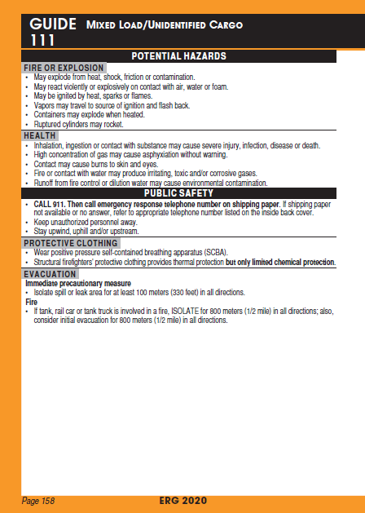
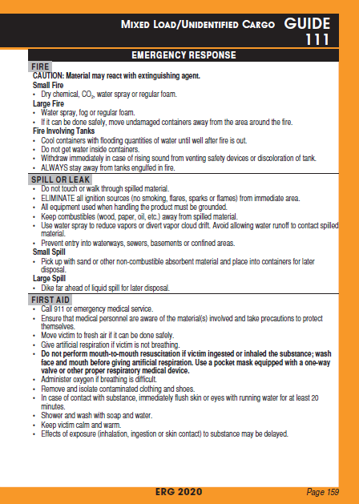
Orange Bordered Pages
These are a 2 page section
These sections are designed for ease of use
Guide 111
Notes:
Notes for the Instructor:
Instruct the students to go to page 156.
The ORANGE guides are set up as a 2 Page Reference section
The left side is broken down into two parts:
Potential Hazards and Public Safety
Potential Hazards is broken into Fire and Health categories
The higher risk category is always listed first
Example: Guide 112 Fire is listed first / Guide 120 Health is listed first
Public Safety
Protective Clothing Recommendations FOR FIRST RESPONDERS ONLY
Evacuation Guide
The right side is the Emergency Response Recommendations:
Fire Actions
Spill Actions
First Aid Actions
GUIDE 111 IS FOR USE ONLY WHEN THERE IS ABSOLUTELY NO OTHER WAY TO DETERMINE THE CHEMICALS INVOLVED

Slide 23
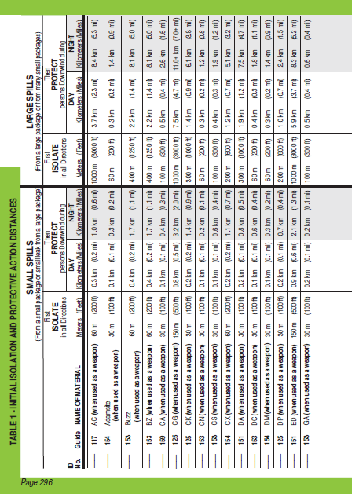
Green Bordered Pages
Distance references
Table 1 – Initial Isolation and Protection.
Table 2 – Water Reactive Materials.
Table 3 – Isolation of TIH Gases.(toxic inhalation hazards)
Notes:
Notes for the Instructor:
Instruct the class to go to page 286.
Page 286 is the introduction the green section
The Green section contains 3 tables
Table 1 – Page 294
Table used to find initial isolation distances as referenced in the yellow and blue sections
Only used if there is no fire
Small spills are less than 55 gallons. Large spills are greater than 55 gallons
NOTE WIND DIRECTION
Table 2 - Page 344
Table 2 Is a list of all water reactive materials identified in this book
These chemicals produce large amounts of Toxic Inhalation Hazard (TIH) gases when mixed with Water
Table 2 is used when a chemical in table 1 has “WHEN SPILLED IN WATER” following its name
Table 3 - Page 350
Table 3 lists the TIH for the six most common TIH gases (Ammonia, Chlorine, Ethylene Oxide, Hydrogen Chloride, Hydrogen Fluoride and Sulfur Dioxide)

Slide 24
Payroll / Credit
Upon completion of the course and testing please enter payroll / credit time into the Emergency Reporting system.
Please enter this info under the unassigned station field at the bottom portion of the daily roster (add person).
Fill in your name as per usual and then the times select the following for the position and activity codes:
Position : Training
Activity :
  CO -Credit Only (on duty)
  TRN- Training Pay (off duty)
  Type mandatories in the note field.

Slide 25
THE EXAM
Access Code: HAZCOM

