Slide 1
Standish Ergonomics
2023

Slide 2
What is Ergonomics?
Ergonomics is the science and practice of designing jobs or workplaces to match the capabilities and limitations of the human body.
Benefits of ergonomics include:
safer jobs with fewer injuries
increased efficiency and productivity
improved quality and fewer errors
improved morale
Notes:
Ergonomics is a science that takes what we know about people’s capabilities and limitations, and applies that knowledge to the workplace.
Ergonomics is a tool that employers can use to make jobs, workstations, and tools to fit the worker. Employers who have implemented ergonomics in their workplaces have found that it greatly reduces injury claims and costs. They’ve found other benefits as well, such as increased productivity and product quality, and improved morale among employees.

Slide 3
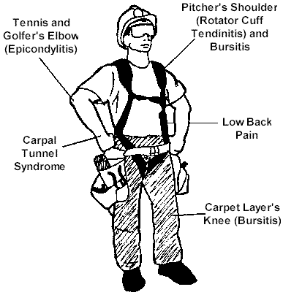
What is a Musculoskeletal Disorder?
An MSD is a disorder of the muscles, nerves, tendons, ligaments, joints, cartilage, blood vessels or spinal discs.

Slide 4
WHAT IS A WMSD?
Workplace MSD’s are caused by
exposure to risk factors such as:
Repetition
Force
Awkward Postures
Contact Stress
Vibration

Slide 5
“Caution Zone” Jobs Require Action
Do you have “caution zone” jobs?
No
Yes
Not covered
No requirements
Two requirements:
Awareness education
Evaluate “caution zone”
jobs for hazards
No hazards
present
Hazards present
No additional
requirements
Reduce exposure below
the hazard level or
to the degree feasible
Annual
review
Annual
review

Slide 6
"Caution Zone"
What is a
“Caution Zone” job?
Caution
Zone

Slide 7
"Caution Zone"
Look for These Indicators:
Awkward Postures
High Hand Force
Highly Repetitive Motion
Repeated Impact
Heavy, Frequent or Awkward Lifting
Moderate to High Hand-Arm Vibration
Caution
Zone

Slide 8
Awkward Postures
Being in these work positions for
more than 2 hours total per day
Hands above head
Elbow above shoulder
Back bent forward more than 30 degrees
Neck bent more than 30 degrees
Squatting
Kneeling
"Caution Zone"

Slide 9
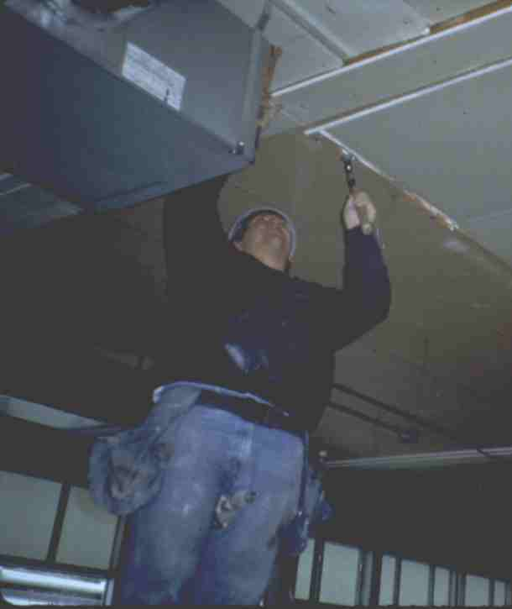
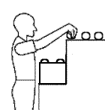
Working with the Hands Overhead
For more than 2 hours per day.
"Caution Zone"

Slide 10
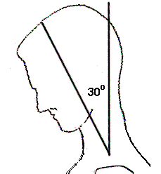
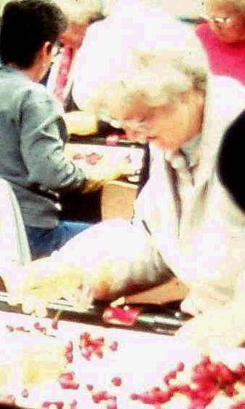
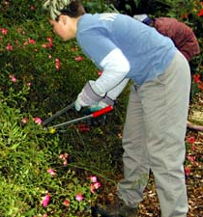
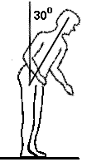
Neck or Back Bent Forward More than 30º
For more than 2 hours per day.
"Caution Zone"
Notes:
Your head weighs 10 to 12 pounds, so it can be quite a strain to work with your neck bent.
Neck posture is only covered by the rule if the worker is not able to vary his or her posture. Working with the neck bent like this is pretty common in inspection jobs, such as with this cherry sorter. It also is common in job such as:
welding,
microscope work,
dental hygienists
Your upper body is 60 percent of your total body weight, so like your neck holding up your head, it’s also a strain for your back to hold you in a bent over position for more than two hours per day, such as landscapers who work near ground level.
Like neck posture, back posture is only covered if the worker is not able to vary his or her posture.

Slide 11
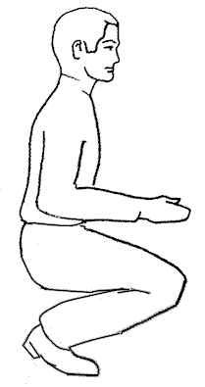
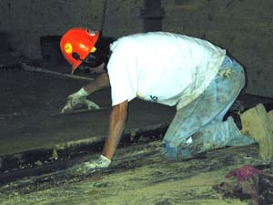
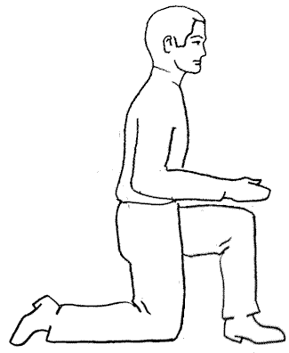
Squatting or Kneeling
For more than 2 hours per day.
"Caution Zone"
Notes:
Squatting is one alternative to bending at the back to get down low, and it’s fine to do for short periods of time. Unfortunately it creates a lot of pressure behind the knee cap and can cause knee injuries over time.
Kneeling also is a risk factor for knee injuries, since it creates pressure both in front of and behind the knee cap.
A lot of construction work requires kneeling for jobs like concrete finishing, carpentry, and carpet and floor laying.

Slide 12
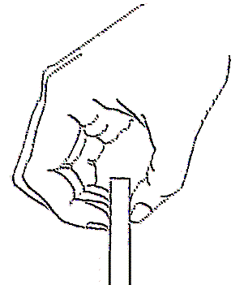
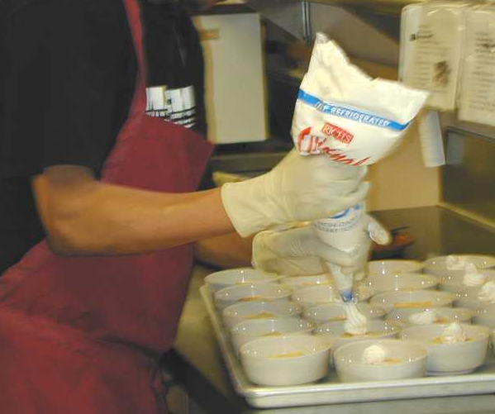
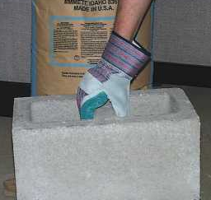
High Hand Force
More than 2 hours per day of:
Pinching 2 or more pounds weight or 4 or more pounds force
Gripping 10 or more pounds weight or force
"Caution Zone"
Notes:
Using a lot of hand force increases the risk for hand, wrist and elbow injuries, and in some cases shoulder injuries.
Holding something between the tips of the fingers and the thumb is called a pinch grip. This type of grip uses very small muscles in the hand and wrist, so even holding something that weighs only 2 pounds can be a risk for injury if it’s done for more than 2 hours per day.
Because you can’t get as good a grip with your fingertips as with your whole hand, you tend to use more force to hold onto something than just the weight of the object. For example, in order to hold onto a stack of paper that weighs two pounds, you actually have to use four pounds of grip force.
Jobs involving pinch force of 4 pounds are also covered, even if the weight being handled is really low. An example would be an assembly job where one of the parts inserted are spring clips that require a pinch force of 4 pounds to open.
When you grip something with your whole hand you’re able to use the larger muscles in your forearm, and this gives you a grip that’s five times stronger than a pinch grip. You’re also able to get a better grip so the amount of grip force you use is pretty much equal to the weight of the object you’re holding.
Therefore, grip force only enters the caution zone if it’s 10 or more pounds of weight held or 10 or more pounds of force exerted, and it’s done for more than 2 hours per day.

Slide 13
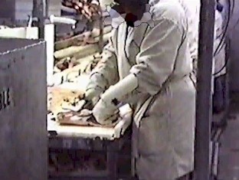
Highly Repetitive Motion
Workers repeat same motion every few seconds for more than 2 hours per day with:
neck
shoulders
elbows
wrists
hands
"Caution Zone"

Slide 14
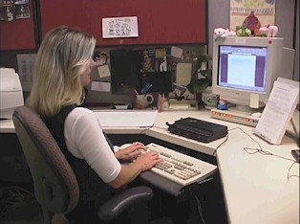
Highly Repetitive Motion
Intensive keying for more than 4 hours per day.
"Caution Zone"

Slide 15
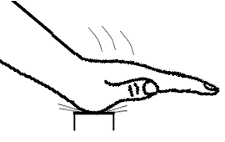
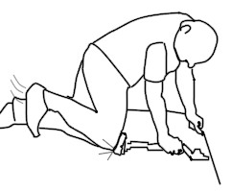
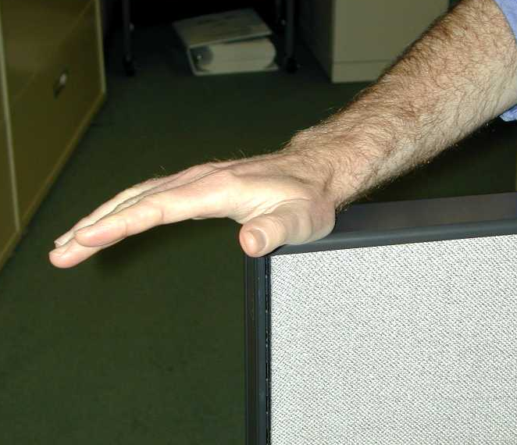
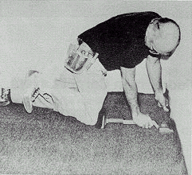
Repeated Impact
Using hands or knees as a hammer
more than 10 times per hour.
more than 2 hours per day.
"Caution Zone"

Slide 16
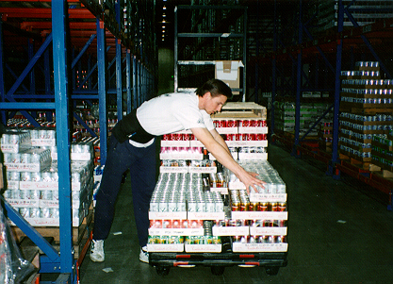
Heavy, Frequent, or Awkward Lifting
Lifting objects more than:
75 lbs. once/day.
55 lbs. more than ten times/day.
10 lbs. more than twice/minute for more than 2 hours/day.
25 lbs. above shoulders, below knees, or at arms length for more than 25 times/day.
"Caution Zone"
Notes:
Just about every job requires some lifting, but lifting only becomes a risk for injury if it’s heavy lifting, it the lifting is done frequently, or if it’s done in an awkward posture.
For the caution zone, heavy lifting is any lift of 75 lbs or more once per day, or 55 lbs ten or more times per day.
Frequent lifting is 10 lbs or more, more than twice per minute, for more than 2 hours per day.
Awkward lifts are lifts of 25 lbs or more above the shoulders, below the knees, or out at arms’ length done more than 25 times per day.

Slide 17
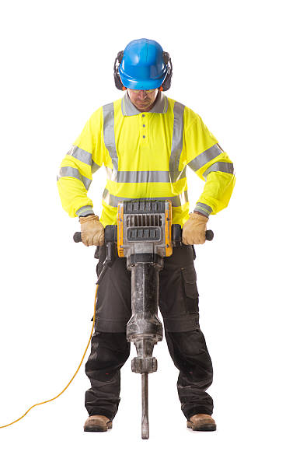
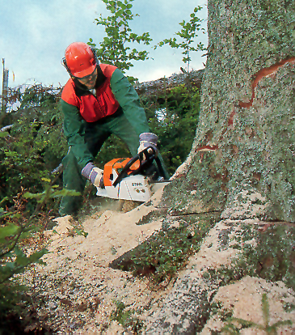
Moderate to High Hand-Arm Vibration
Moderate Level
More than
2 hours/day.
High Level
More than
30 min/day.
"Caution Zone"

Slide 18
Analyzing Caution Zone Jobs for Hazards
Use a systematic method to look at:
physical demands
layout of work area
size, shape, and weight of objects handled
The results will help to determine controls
"Hazard"
Notes:
If you have employees whose jobs involve one or more of the risk factors we’ve talked about, then they are in the caution zone and they need to receive the awareness education. You also need to analyze these jobs to see if they are hazardous and need to be corrected. Your analysis needs to go beyond just whether or not there are risk factors, to try and find out what about the workplace or the job is creating the risk factors.
Physical demands include the risk factors we’ve talked about, but also the pace of work, whether the tasks are all the same or if there’s variety, and how much recovery or rest time there is between tasks.
Layout of the work area includes things like reaches, height of the workstation, chair, conveyor or whatever it is the employee works with or on to see if it is causing awkward postures.
Things you need to analyze for lifting jobs are the size, shape and weight of objects being lifted.
The point of this analysis is to see if a caution zone job is hazardous, and to help figure out the best way to control the hazard. For example, if the size and shape of a box requires workers to reach way out when lifting it, maybe a smaller box could be used.

Slide 19
Hazard Zone (use Appendix B)
Risk factors become hazardous when:
there is a longer duration of exposure
"Hazard"

Slide 20
Hazard Zone (use Appendix B)
Risk factors become hazardous when:
there is greater intensity
"Hazard"

Slide 21
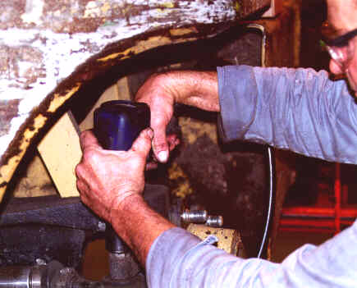
Hazard Zone (use Appendix B)
Risk factors become hazardous when:
there is a combination of risk factors
"Hazard"

Slide 22
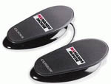
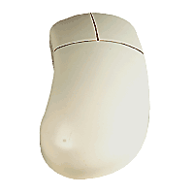
Ergonomic Solutions
Using foot controls instead of standard mouse controls
"Solutions"

Slide 23
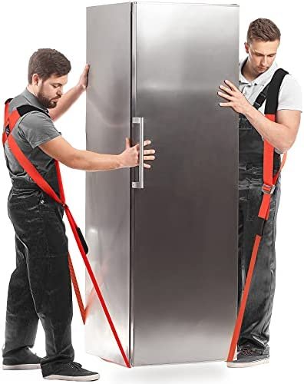
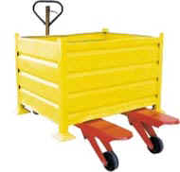
Ergonomic Solutions
Lift assist device to eliminate heavy,
awkward lifts
"Solutions"

Slide 24
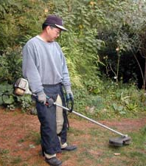
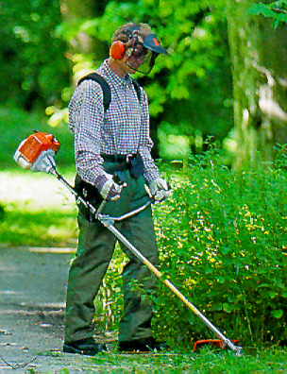
Ergonomic Solutions
Shoulder harness for landscaping tool to reduce hand forces
"Solutions"

Slide 25
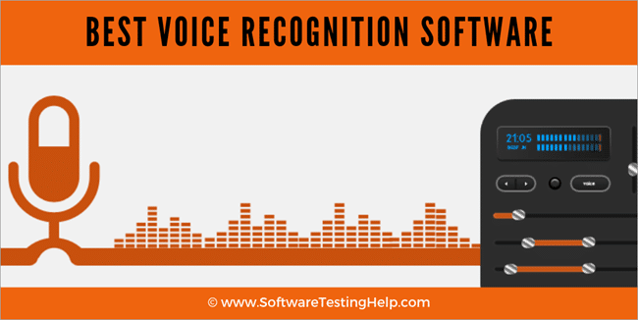
Ergonomic Solutions
Voice activated software to eliminate keystrokes
"Solutions"

Slide 26
If You Have “Caution Zone” Jobs
Begin an employee awareness education program
Analyze your workplace for hazards
Reduce any hazards you find
Notes:
Employees in caution zone jobs (and their supervisors) need to be provided with general ergonomic awareness education.
These jobs also need to be looked at in more depth to determine if they have hazards that require controls and to discover what is causing the hazards identified.
If hazards are identified, they need to be reduced below the hazardous level, or to the degree feasible. We’ll talk more about hazard levels and feasibility later.

Slide 27
Ergonomics Awareness Education Should:
Provide information on all “caution zone” risk factors
Show the types, symptoms and impacts of WMSDs
Show the importance of early reporting of symptoms
Identify the hazards and measures to reduce them
Teach the requirements of the ergonomics rule
Notes:
These are the specific elements listed in the rule that need to be covered in the ergonomics awareness education.
Notice that information on all the caution zone risk factors is covered - this helps to make the education truly portable so that employees will be aware of different risk factors that may be present in any job they perform.

Slide 28
Reducing Identified Hazards
You need to reduce hazards to below hazard level, or to a degree technologically and economically feasible through:
Engineering and administrative controls (preferred) and/or
Individual work practices and PPE
Employers are not required to reduce employee hours to comply
Notes:
Hazards that are identified during the job analysis need to be reduced below the hazardous level or to the degree technologically and economically feasible. The hazardous level would be that level specified in the General Performance Approach method chosen or in Appendix B if the employer is using the Specific Performance Approach.
We expect that in the large majority of situations there will be simple and affordable controls to reduce hazards, however the concept of feasibility recognizes there may be special situations where we may not yet know how to reduce the hazard below the hazardous level, or the control would not be economically possible for an employer. This feasibility issue is one we deal with in other safety and health rules too.
Engineering or administrative controls such as changes to workstations and tools, process redesign to eliminate unnecessary steps, or job rotation are preferred hazard control methods. If these are not effective in reducing the hazards below the hazardous level, the employer needs to use individual work practices or personal protective equipment (if feasible) as interim measures to supplement the other hazard controls.
The rule does not require an employer to replace full-time employees with part-time employees or otherwise reduce worker’s hours of employment to comply.

Slide 29
Job-Specific Training
Job-specific training is required only if controls change the job or work practices
Training must include:
hazards of the work activities
safe work practices
proper use and maintenance of control measures
Notes:
Job-specific training is required in those cases where measures to reduce WMSD hazards have resulted in changes in a job or work practices.
Job-specific training needs to include:
the hazards of the job or work activities
safe work practices, and
proper use and maintenance of the control measures

Slide 30
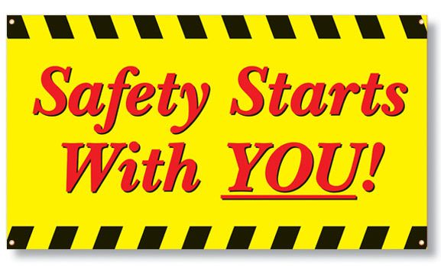
Employee Involvement
Your safety committee should be involved in selecting the methods of employee participation
Involve your employees in:
Analyzing “Caution Zone” Jobs
Selecting hazard control methods
Reviewing ergonomics activities annually
Results should be shared with your safety committee
Notes:
Employee involvement is an important element of the Ergonomics rule.
If employers are required to have a safety committee, then the committee needs to be involved in choosing the methods to be used for employee participation.
Employees need to be involved in analyzing caution zone jobs and selecting measures to reduce WMSD hazards.
Employers must share information about the ergonomics rule, caution zone jobs, job analysis, and hazard controls with the safety committee or at safety meetings.
Finally, employers need to involve employees in an annual review of ergonomics activities to evaluate needed improvements.

Slide 31
Remember: “Caution Zone” Jobs Require Action
Do you have “caution zone” jobs?
No
Yes
Not covered
No requirements
Two requirements:
Awareness education
Evaluate “caution zone”
jobs for hazards
No hazards
present
Hazards present
No additional
requirements
Reduce exposure below
the hazard level or
to the degree feasible
Annual
review
Annual
review

Slide 32
It Costs Less to Be Safe
Average cost of
Average cost of
common
WMSD’s*:
common controls:
Low back: $6,000
Hydraulic lift: $600
Shoulder: $7,000
Workstation: $800
Adjustable height
Elbow: $4,000
Powered Screwdriver: $100
Wrist: $5,500
Powered screwdriver:
Assembly work
positioner: $75
* Source: SHARP Report No. 40-4a-2000

Slide 33
Standish Ergonomics
Exam access code - THERGO

